Slide 1
What do we do for holidays?
Made by:
Marko Delija
Tamara Jurkić
Mihaela Kraljić

Slide 2
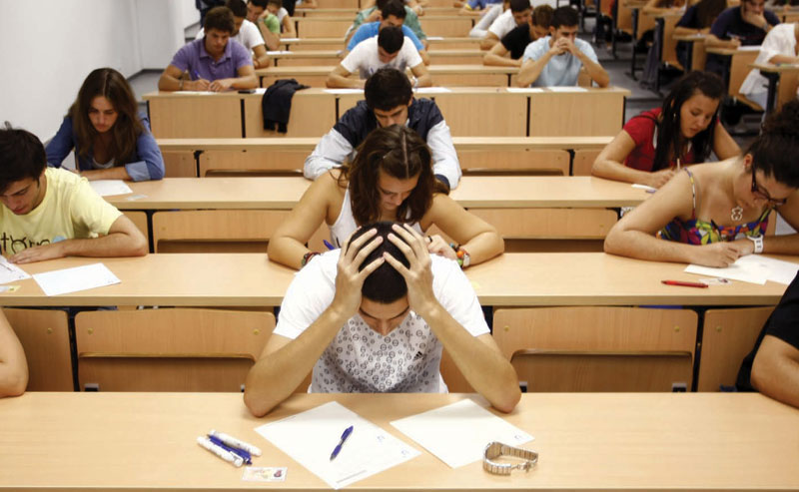
Participants
students aged 15 to 18
159 participants: 108 girls - 68%
51 boys - 32%

Slide 3
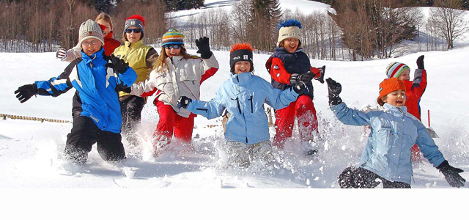
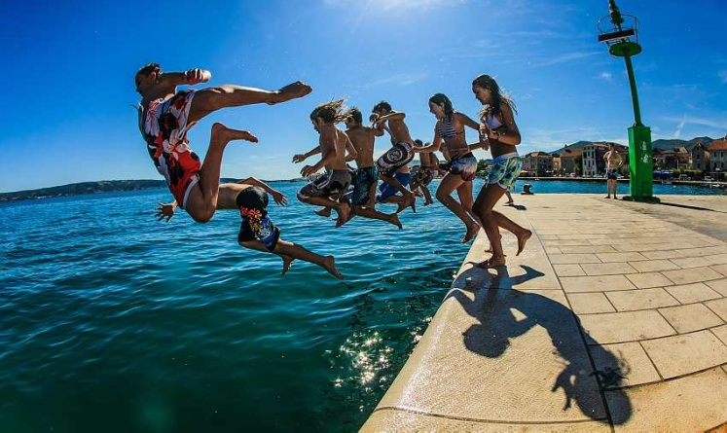
School holidays
20 days of winter holidays
10 days of spring break
almost 3 months of summer holidays with an obligation to do summer practise

Slide 4
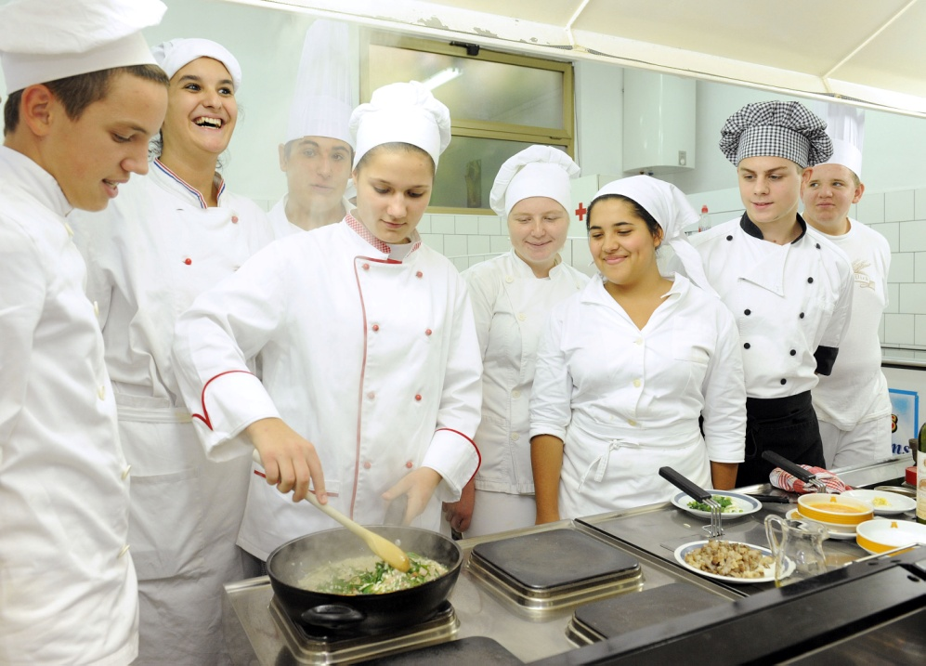
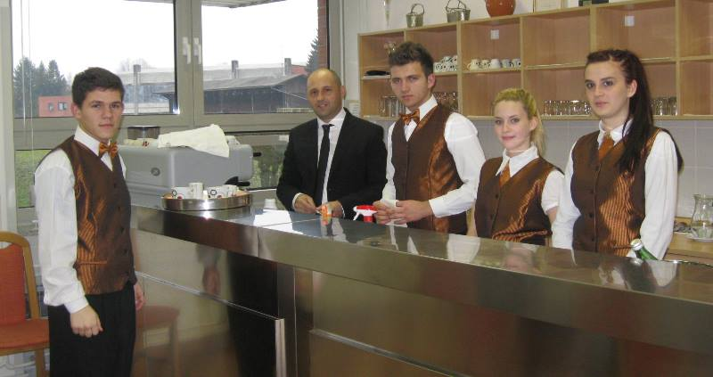
Summer practise

Slide 5
Students do practise at:

Slide 6
During holidays students:

Slide 7
Students usually travel because of:

Slide 8
As tourists they travel:

Slide 9
Amount student's family
can set aside for a trip:

Slide 10
Usually they travel by:

Slide 11
During 2014 the students usually travelled within Croatia. 56% of them travelled to seaside and 18% spent their holidays at inland.

Slide 13
25% of students travelled abroad (Bosnia and Herzegovina, Serbia, Austria, Germany, France). 2% students did not travel anywhere.

Slide 16
Thank you for your attention ☺

