Slide 1
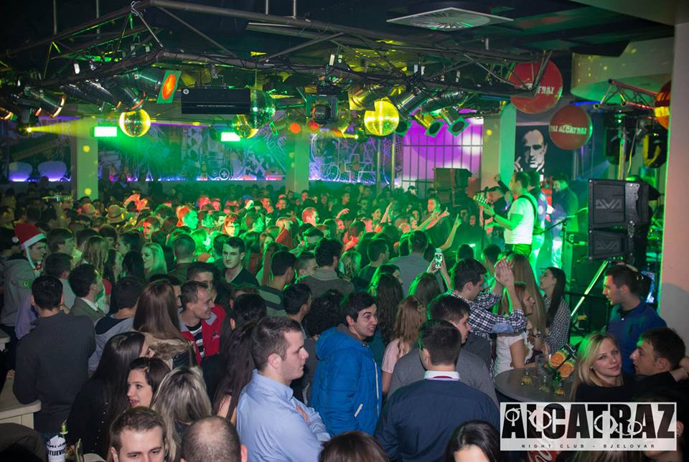
Bjelovar vs
Örebro
Made by:
Davorka Pleško
&
Matea Omerović

Slide 2
Rights and responsibilities
Teenagers in Croatia are not very independent
We have access to free education and only the best ones are able to get some kind of support/scolarship
Primary school is compulsory, secundary is not

Slide 3
What to do in Bjelovar
We have many caffe and night bars in the city, so during weekend we mostly go out
We have cinema (Kulturni i multimedijski centar)
We have outdoor pool to enjoy during the summer
Bjelovar is famous for Terezijana – event with concerts

Slide 4
We made a survy about Free time and night life of teenagers in Bjelovar…

Slide 5
140 participants of Hospitality and Catering School Bjelovar
96 girls/68,57%/
44 boys /31,43%/

Slide 6
Students spend their free time:

Slide 7
Age students started going out:

Slide 8
Places students go out to:

Slide 9
Students go out:

Slide 10
Students go out with:

Slide 11
Students stay out till:

Slide 12
Students drink alcohol on their night out:

Slide 13
According to their experience, waiters and bartenders sell them alcohol:

Slide 14
In their opinion,prices of drinks(non alcohol and alcohol) in bars and clubs are too high:

Slide 15
Are you familiar with the Family Act which says:
„For child‘s wellbeing, and according to his/her age and maturity, parents have the right and duty to supervise how and who with they spend their time with.
Parents have the right and duty to forbid teenagers younger than 16 to go out if they are not supervised by them or other trustworthy person.
Night out is considered time from 11 PM to 5 AM.

Slide 16
Additional comments:
We wish for more free time
We go out with older siblings so our parents will feel we are safe
We spend time with friends,play board games or cards,do sports

Slide 17
Thank you for your attention!

